Slide 1
Automatic Irrigation System
Presented
By
Eashan Verma 1910992560
Under the Supervision
of
Dr. Preetinder Brar (Associate Professor)
Department of Computer Applications
Chitkara University, Punjab

Slide 2
Introduction
Now-a-days it's been a big challenge for conservation of the water as nearly 80% of the water present on the earth is used for agricultural purpose. As population is increasing day by day, the demand for food never dies and so some smart technologies have been implemented for the better agricultural growth. Considering the electronics region, many smart projects have been implemented for agricultural purpose and one of them is A Low Cost Arduino based Automatic Irrigation System using soil moisture sensor. It automatically turns ON/OFF depending on the conditions of the soil. If the soil is in dry condition, then the motor turns ON automatically and in case if it is in Wet condition, then it automatically get's turned OFF. An Automatic Irrigation system not only turns ON/OFF depending on the soil conditions but also reduces the human interference and human labour towards the work. It also saves the time and also the water as excess water leads to damage of the crops. During summers, a great many people are as well languid to water the pruned plants on their roof gardens consistently. In the realm of advance gadgets life of individuals ought to be less complex thus to make life less complex and advantageous, so I have made "Automatic Irrigation System".

Slide 3
Problem statement
Many farmers nowadays, unknowingly, Pour more water in the soil than required which makes it watery and soil loses its nutrients which makes crops difficult to grow on such soil. My system, that is a low-cost irrigation system, will help them to get to know about the right amount of water to be put in the soil to make it worth planting the crops. It is a low-cost and easy to use system and will be feasible with farmers and anyone fascinated with the plants at their homes can to use so that flowers don’t shed their grace.

Slide 4
objectives of the project
*To reduce the wastage of water.
*To make them, users of the project, understand the importance of soil and its nutrients needed to grow the plantation.
* To make it affordable and easy to use for farmers.

Slide 5
Software/ Hardware Requirements
    * Hardware:-
16×2 LCD.
5v adapter.
Relay circuit 5V.
Potentiometer 10 ohm.
5v wires acting as float switch connected to potentiometer.
1k ohm resistor.
Pump.
Float pipe.
Soil Moisture
* Software:-
*Operating System: Window 10.
*Arduino IDE.

Slide 6
Functionality
The system is designed in such a way that when soil moisture level sensor sends signals to the Arduino the signal pulses will be sent to the relay circuit. It will further send signal to float wire that when to pour-out the water from the tank.

Slide 7
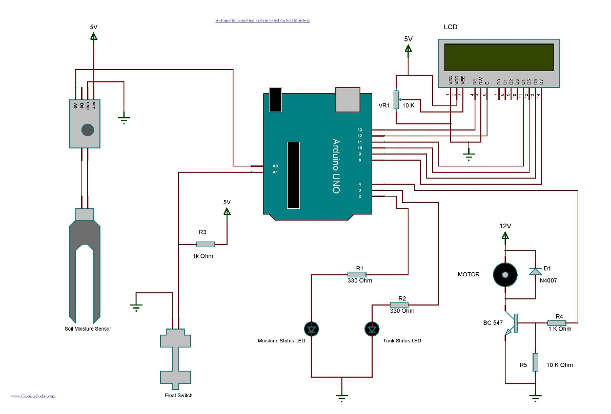
Architecture

Slide 8
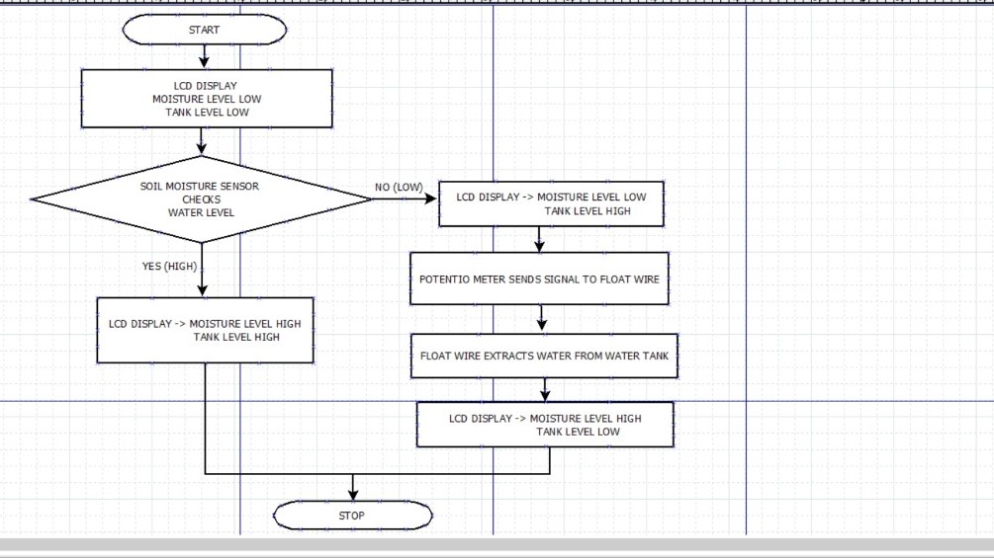
Working design(DFD)

Slide 9
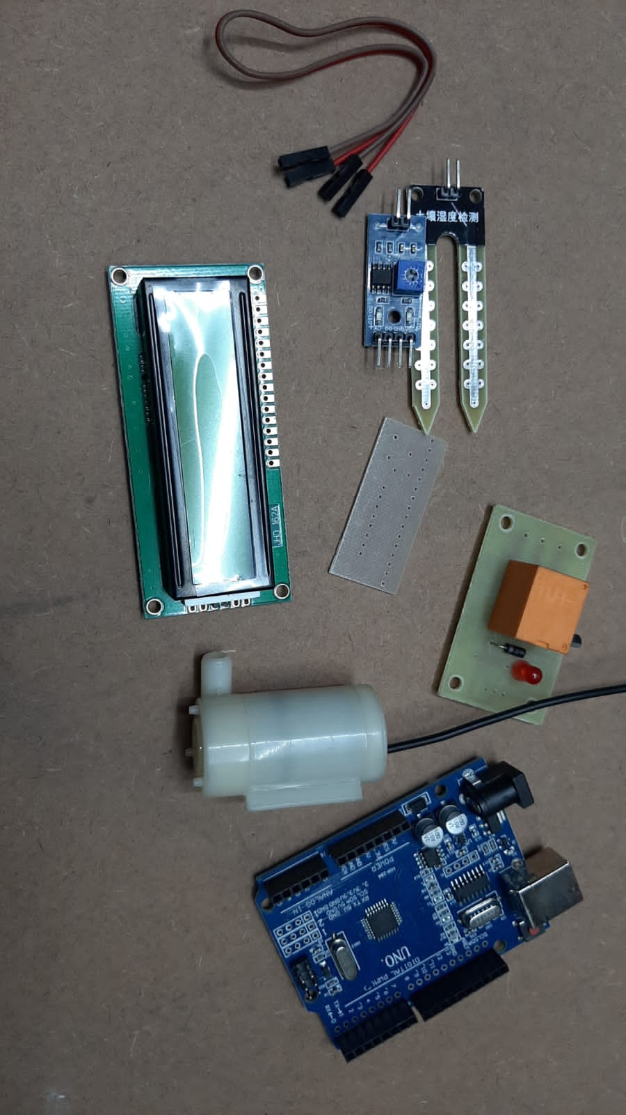
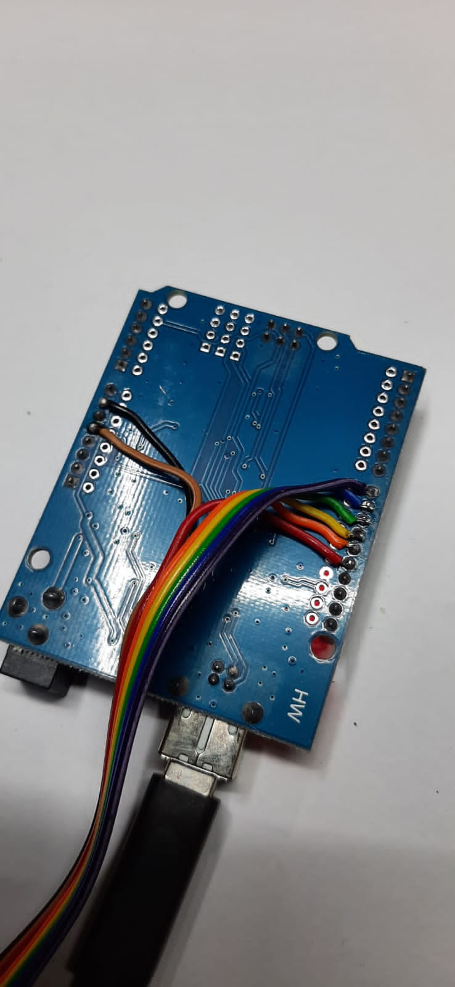
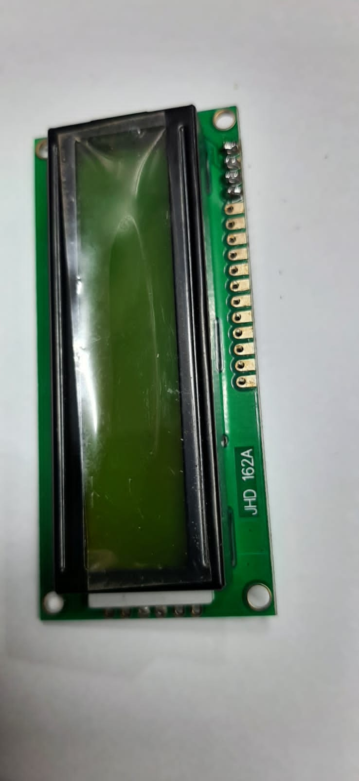
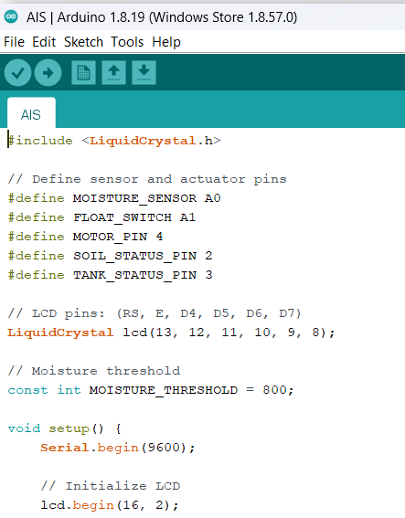
Execution of the project

Slide 10
References:-
1. https://www.arduino.cc/en/software (Arduino IDE)
2. https://en.wikipedia.org/wiki/Soil_moisture_sensor (Soil Moisture Sensor)
3. https://www.arduino.cc/
4. https://www.elektor.com/c-programming-with-arduino
5. https://www.circuitstoday.com/automatic-irrigation-system-arduino

